Slide 1
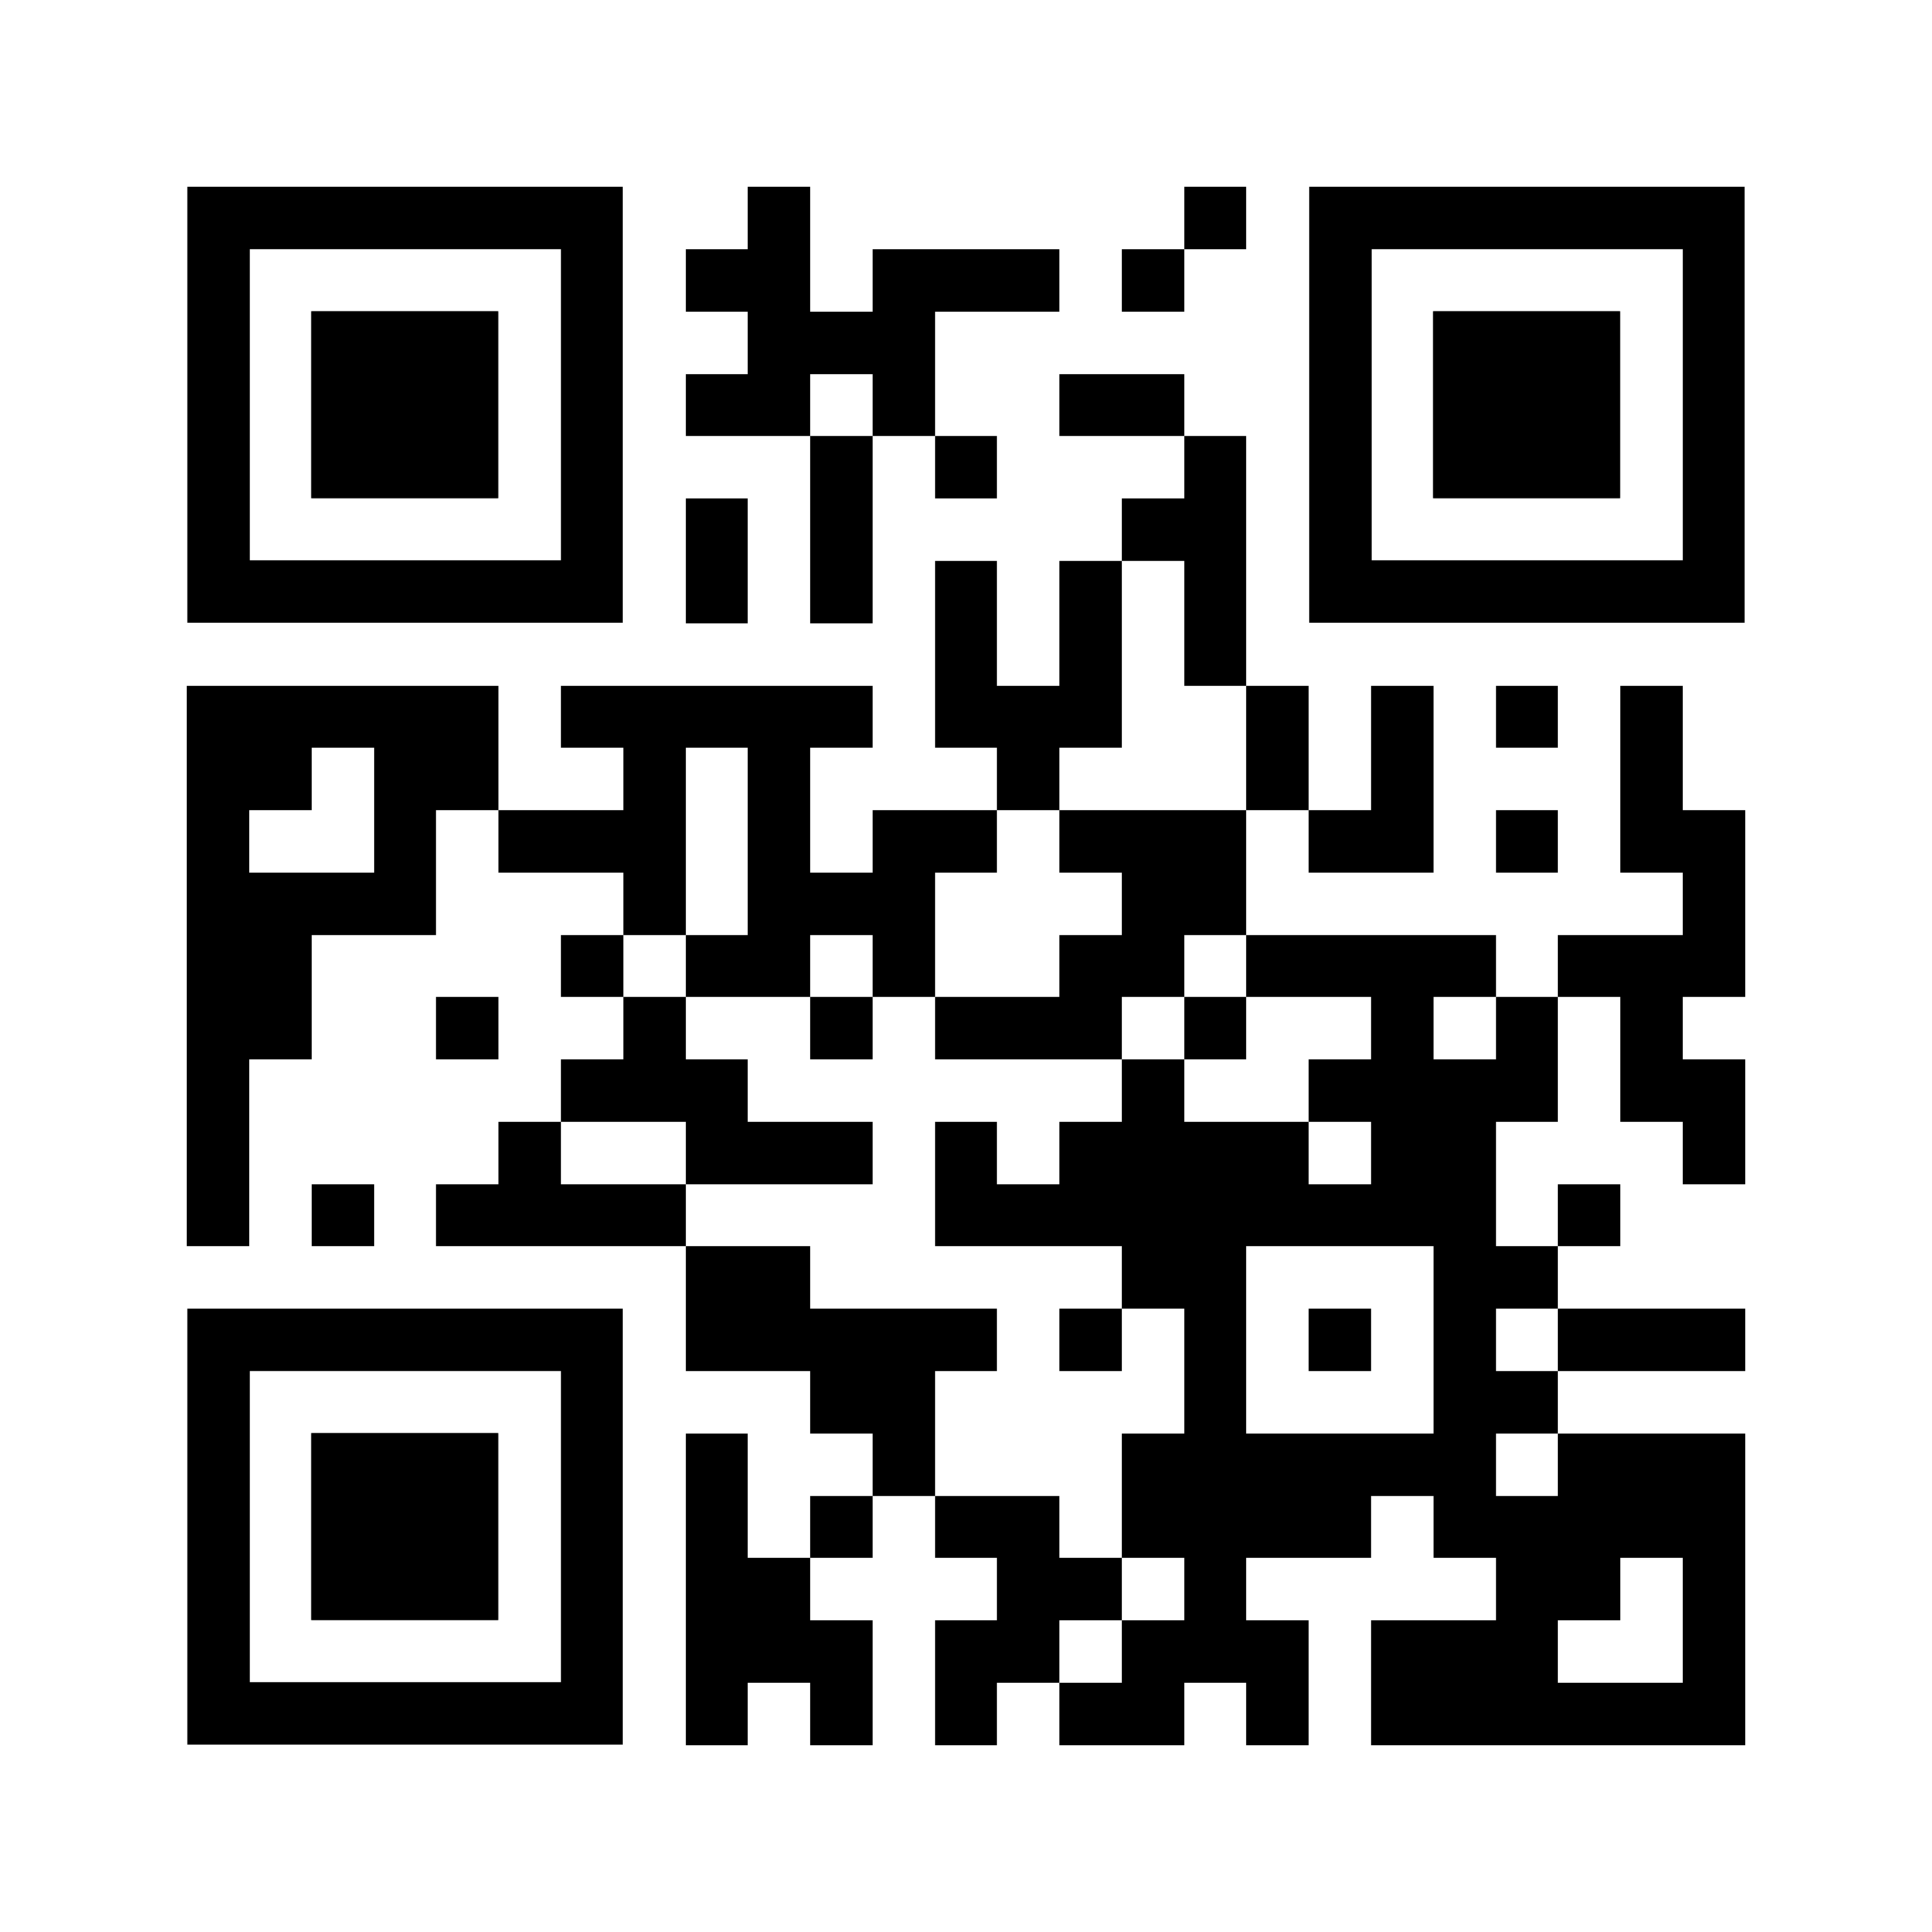
Experimental Research of Proactive Dissemination is Missing
Dublin, We Have Contact? Analysis of Preventative and Community-Level Interventions in the Contextual Behavioral Sciences
Definitions:
Scientist Practitioner Model
“A model intended to prepare individuals both to provide services and to conduct research on mental health problems”
Preventative Health
Interventions intended to mitigate risk factors predictive of future complications.
Community-Level
Traditions, rituals, habits, or other behaviors common amongst the general population.
Subject Type:
Article Type:
Goal:
- Inspire Preventative Health and Community Level Work!
MICHELLE FORMAN, Patrick Smith, Angel Depriest, Jose Ruiz
INTRO
The levels of contact between a client-clinician relationship to the community at large was reviewed through the lens of the scientist-practitioner model.
METHODS
Searched JCBS for keywords including:
Community
Preventative
Prosocial
Reviewed the matched articles for interventions at levels other than the direct sufferer. (e.g. parents, trainers, community members)
RESULTS
166 of 322 total JCBS articles matched for keywords. Of the 166, only 18 were experiments intervening at a level other than the direct sufferer.
Community-Level
Preventative Health
Problem Awareness
MORE PROACTIVE
Treatment Seeking Contact
MORE REACTIVE
DISCUSSION/FUTURE RESEARCH
Disseminating technology at the preventive health or community-level are where we can proactively target risk factors and move beyond traditional reactive strategies. Experimental research at these levels identifies the most effective methods.
Take a picture to download the poster citations

